Slide 1





CSE-351 Introduction to Artificial Intelligence
Project presentation
AI-Powered Waste Classification
Rokaya Ramy 22-101171
Omar El Nabarawy 22-101123
Jana Sherif 22-101234

Slide 2

Problem Statement
Waste mismanagement is a persistent global issue. A significant portion of recyclable materials is incorrectly sorted and ultimately sent to landfills, contributing to environmental pollution and the depletion of natural resources. Manual sorting methods, commonly used in recycling facilities, are labor-intensive, inconsistent, and prone to human error.
In this project, we address the need for an automated, intelligent solution to improve the accuracy and efficiency of waste classification. By leveraging computer vision and deep learning, our goal is to develop a Convolutional Neural Network (CNN) capable of classifying images of waste into categories such as plastic, paper, metal, and glass. This AI-driven approach has the potential to streamline recycling workflows, reduce operational costs, and support broader sustainability efforts.

Slide 3



Dataset Overview
Recyclable and Household Waste Classification Dataset - Kaggle
Number of images per class
Number of Classes
~500
20
Size of images
Number of images
256 x 256
~10,000
pixels

Slide 4
Data Preprocessing
Dataset Loading, Transformation and Splitting:
A custom dataset class named LoadDataset was implemented to efficiently manage the dataset loading.
Several important Transformations were applied to all images to ensure consistency in the input:
Resizing - 224x224 pixels
Conversion to Tensor
Normalization
The dataset is then divided into three subsets based on predefined proportions:
Training set: Consists of the first 60% of the shuffled images.
Validation set: Contains the subsequent 20% of the images.
Test set: Includes the final 20% of the images.
Training Hyperparameters:
Several key hyperparameters for the training process are also established at this stage:
Batch size = 32
Number of Epochs = 15
Learning rate = 0.001
Data Augmentation:
Data augmentation techniques like Resizing, Random Horizontal Flipping, and Color Jittering were applied to improve generalization.

Slide 5
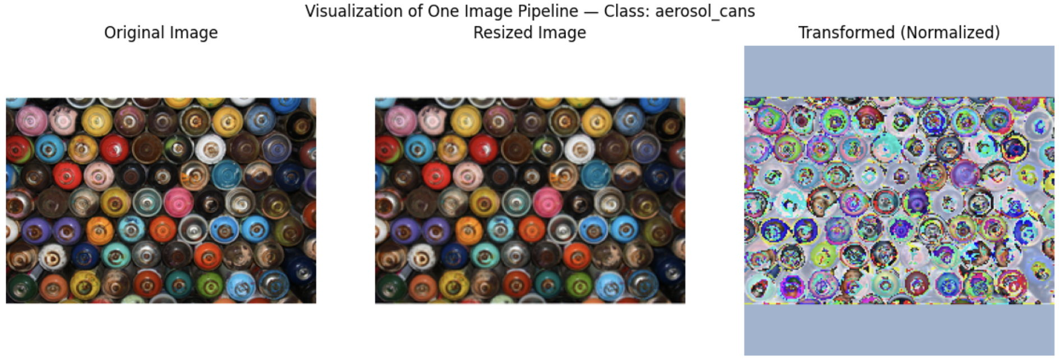
Visualization of Image Preprocessing
Randomly Selected Image - Class: Aerosol Cans

Slide 6
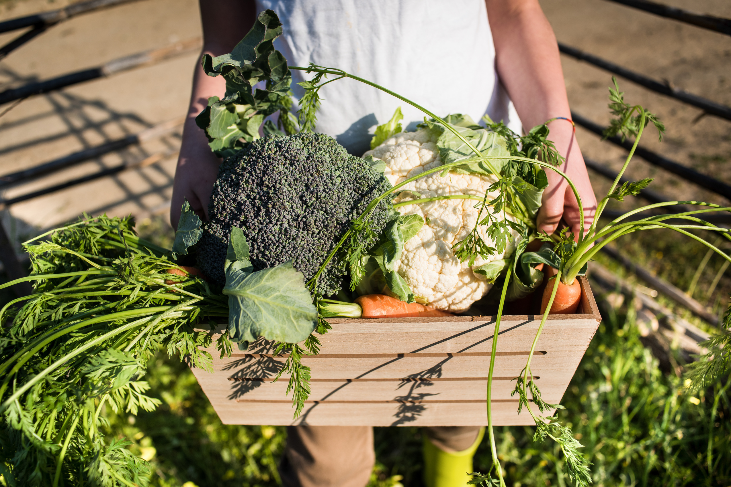
Model Architecture
We trained a custom CNN model using a dataset of 10,000 labeled images, resized to 224×224 resolution.
Training was done over 25 epochs with batch size = 32
Used Adam optimizer with learning rate 0.001 and used CrossEntropyLoss as the loss function.
Used validation set for performance monitoring.
Used early stopping to monitor validation loss.
The training process showed consistent convergence, with training and validation accuracy improving steadily.
We chose a simple CNN architecture because it balances performance with efficiency, making it well-suited for image classification tasks on small to mid-sized datasets like ours. Its straightforward structure also allows for easier tuning, faster training, and better interpretability.

Slide 7
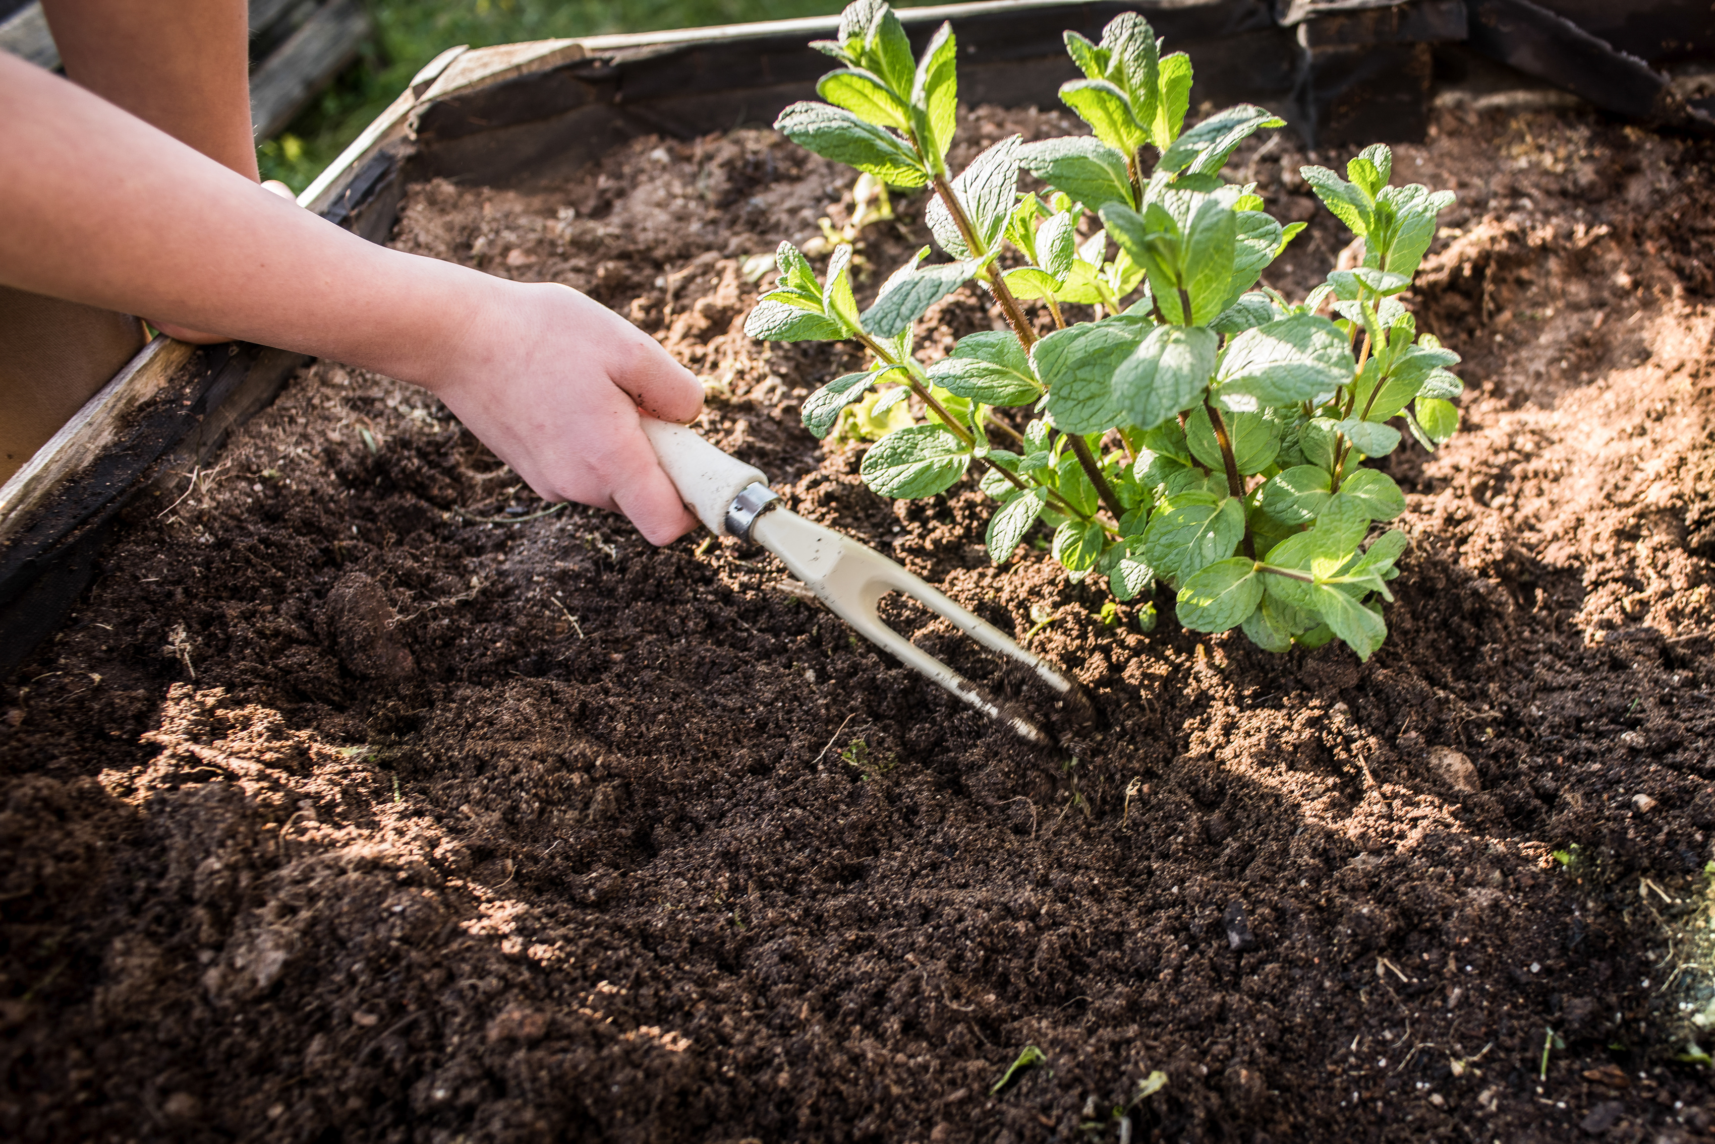
Model Architecture
5 convolutional layers with increasing filters (32 → 512)
ReLU activation after each conv layer
MaxPooling after each block to reduce spatial dimensions
2 Fully-connected layers at the end for classification
Conv1
+
ReLU
+
MaxPool
Conv1
+
ReLU
+
MaxPool
Conv1
+
ReLU
+
MaxPool
Conv1
+
ReLU
+
MaxPool
Conv1
+
ReLU
+
MaxPool
AvgPool
+
Flatten
fc1
+
ReLU
drop
out
fc2
Output:
logits vector of size 20

Slide 8
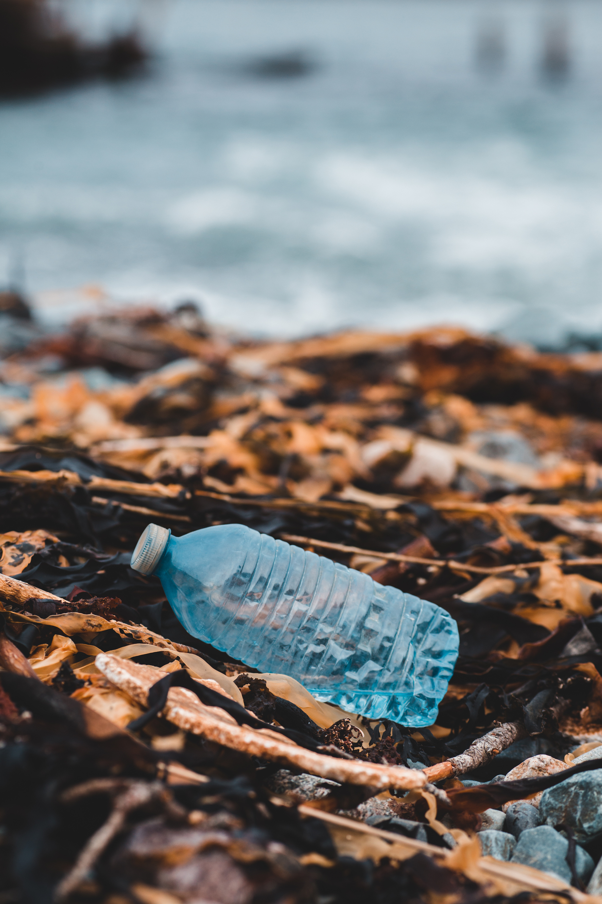
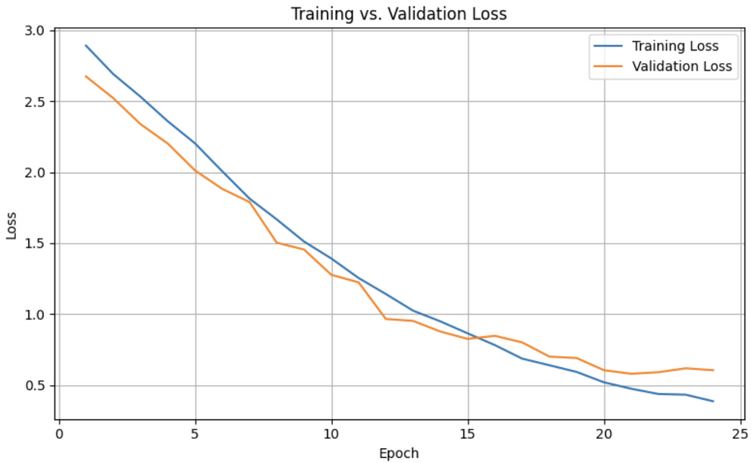
Training and Validation
During training, we evaluated the model on a separate validation set after each epoch. This allowed us to monitor generalization performance and detect overfitting early. The plot shows how training and validation losses evolved over time.
Training vs Validation Loss Curves

Slide 9
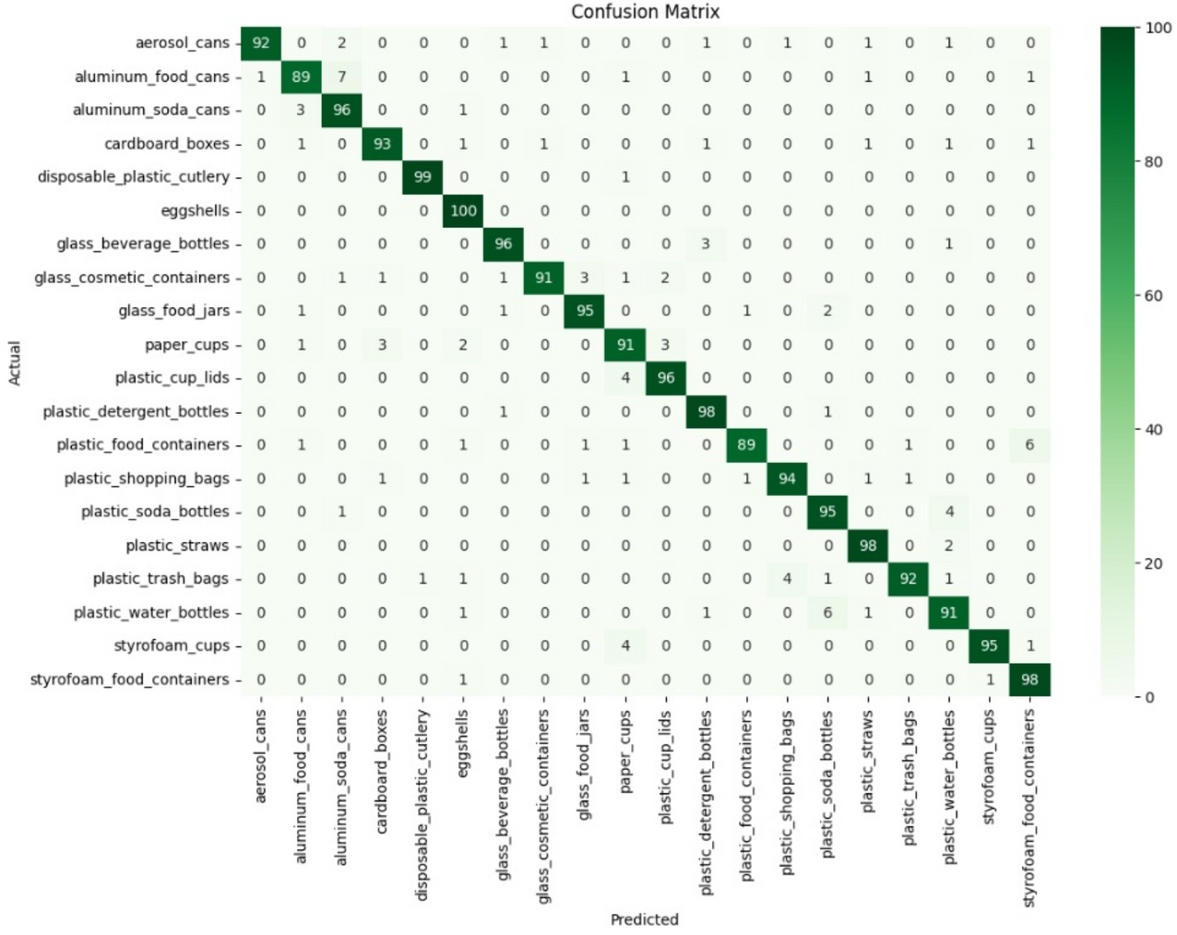
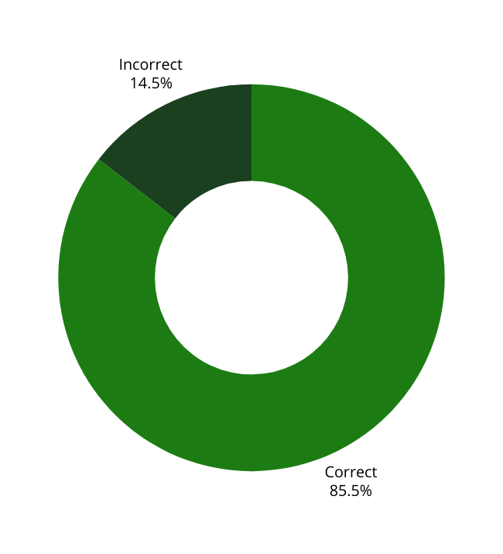
Testing and Evaluation
Model Evaluation Metrics:
After testing the model on the test dataset, the model provided the following evaluation metrics:
Accuracy: 0.8550
Macro-Averaged F1-score: 0.8562

Slide 10
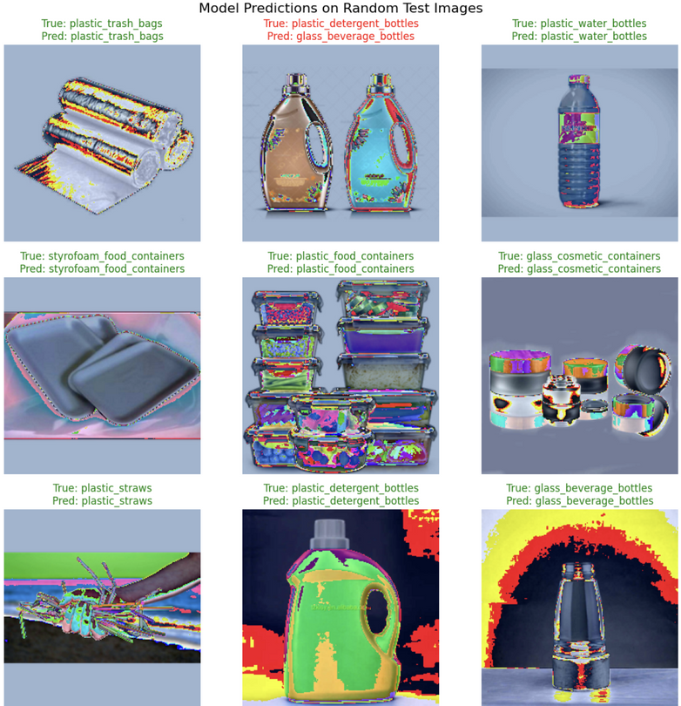
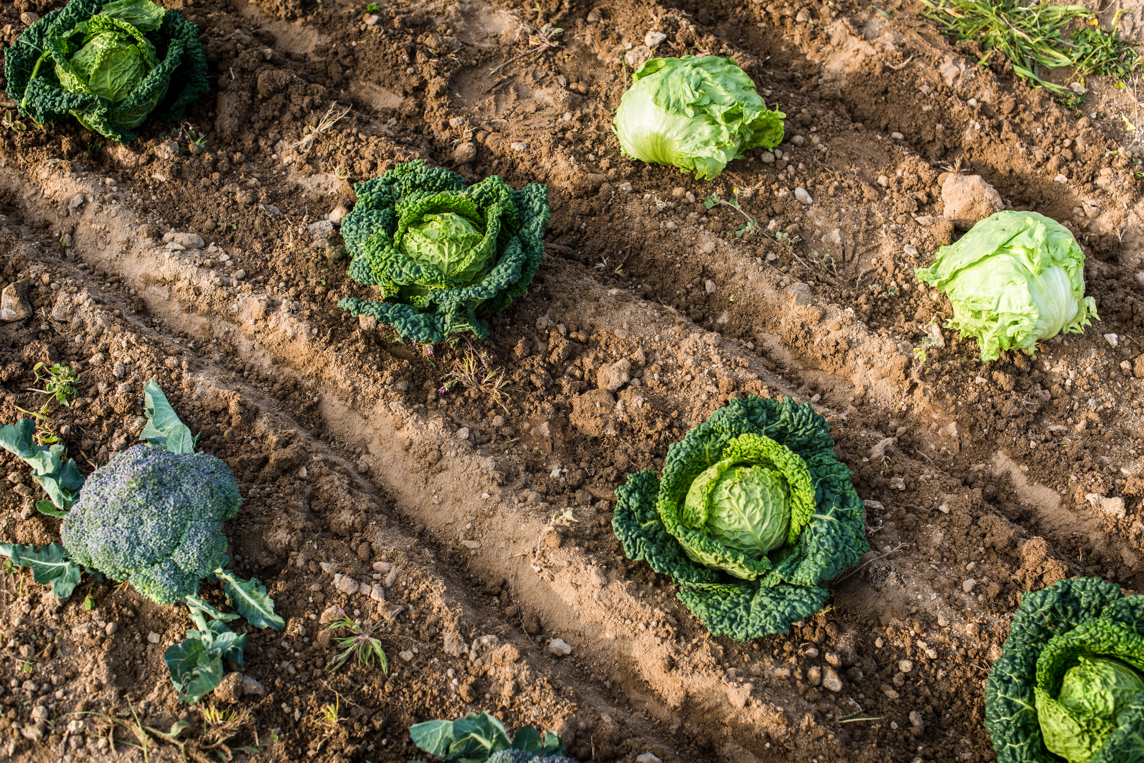
Results and Insights
Our model achieved strong performance on the test set, with an accuracy of 0.8550 and an F1-score of 0.8562, indicating balanced classification across most categories. The confusion matrix showed that commonly confused classes were plastic_water_bottles and plastic_sode_bottles, likely due to visual similarities in certain images.
Training and validation curves demonstrated good convergence without signs of significant overfitting, suggesting that our model generalizes well to unseen data. Data augmentation played a key role in enhancing robustness.
Model Prediction on randomly selected input

Slide 11
Extra Model - ResNet18
To benchmark our custom CNN, we also used ResNet-18, a widely adopted deep convolutional neural network pre-trained on ImageNet. By replacing the final classification layer with a 20-class output, we fine-tuned the model on our waste classification dataset.
Using transfer learning allowed the model to leverage powerful feature extraction capabilities learned from large-scale natural image data. This led to improved performance in both accuracy and generalization compared to training from scratch.

Slide 12

Model Comparison
In addition to our custom CNN, we evaluated a pretrained ResNet-18 model for comparison. ResNet-18, with its deeper architecture and transfer learning benefits, provided a useful benchmark. The table below summarizes the performance of both models on the test set.
features | Custom_CNN_model | ResNet18 Model (Pretrained)
Model Type | Custom-built convolutional neural network | Deep residual network (ResNet18) with pretrained weights
Architecture Depth | 5 convolutional layers + 2 fully connected layers | 18 convolutional layers with residual (skip) connections
Pretrained Weights | No (trained from scratch) | Yes (pretrained on ImageNet dataset)
Epochs | 25 epochs | 25 epochs
Accuracy | 0.8550 | 0.8845
F1-score | 0.8562 | 0.8865
Training loss | 0.3467 | 0.1176
Validation loss | 0.6797 | 0.4720
Hardware Requirement | Moderate | Higher GPU memory and compute power required

Slide 13
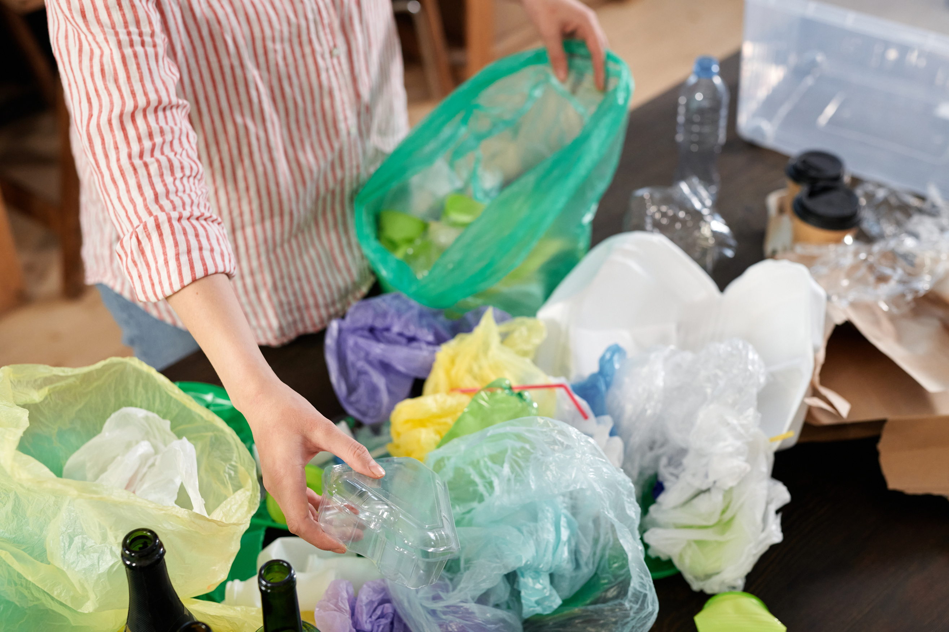
Conclusion
This project demonstrates the practical application of deep learning in automating waste classification. By leveraging a CNN model, we created a system capable of efficiently identifying recyclable materials from images. Our work highlights the potential of AI to support sustainability efforts and reduce the burden of manual waste sorting.
Looking ahead, expanding to more diverse datasets and integrating detection or mobile deployment could bring this solution closer to real-world use.

Slide 14
Thank You

